Slide 1

sihyeon1804/webpgm

Slide 2


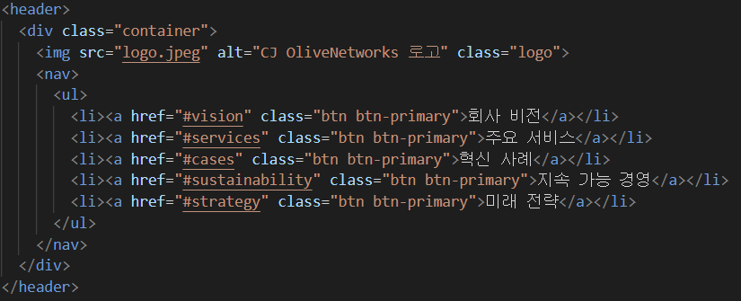
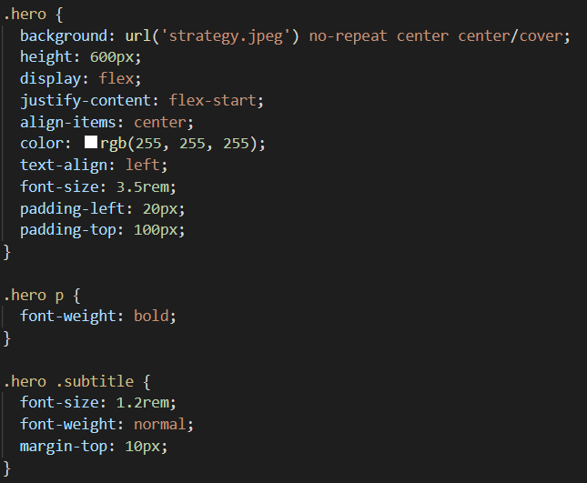
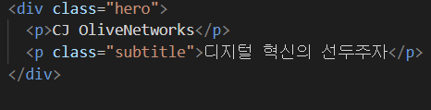
로고와 메뉴 바
관련 css
메인배너

Slide 3
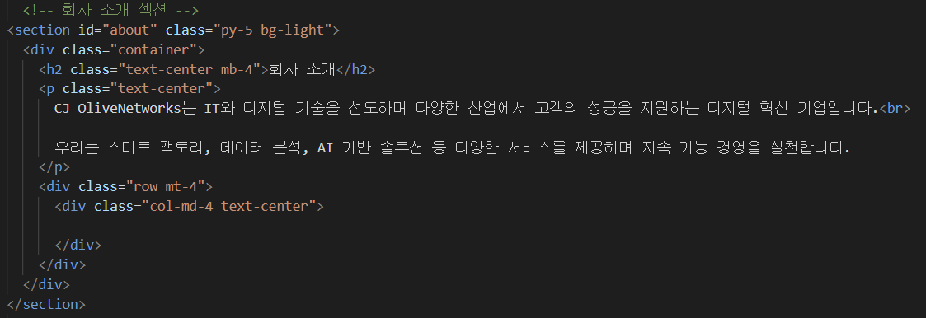
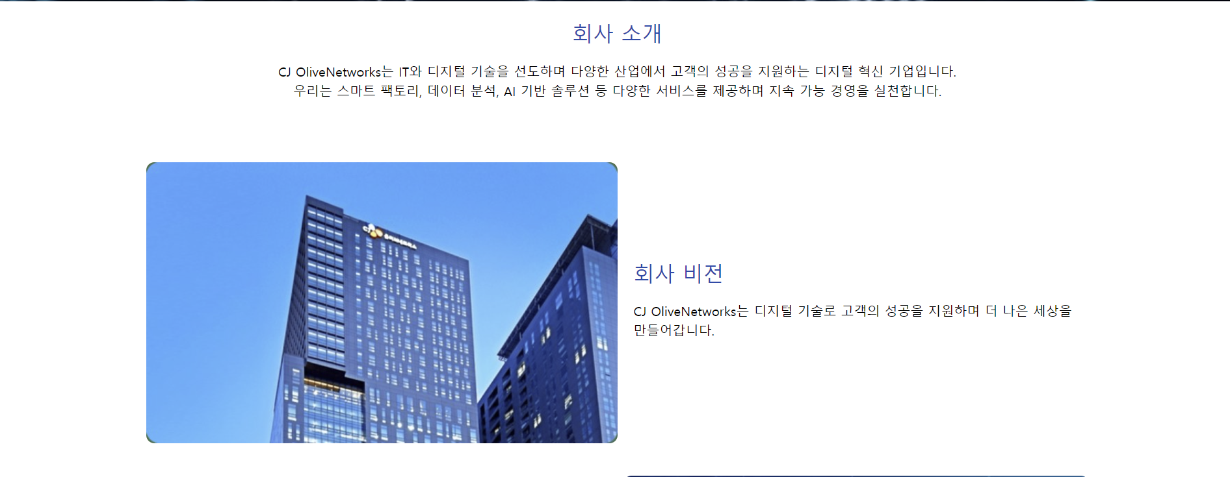
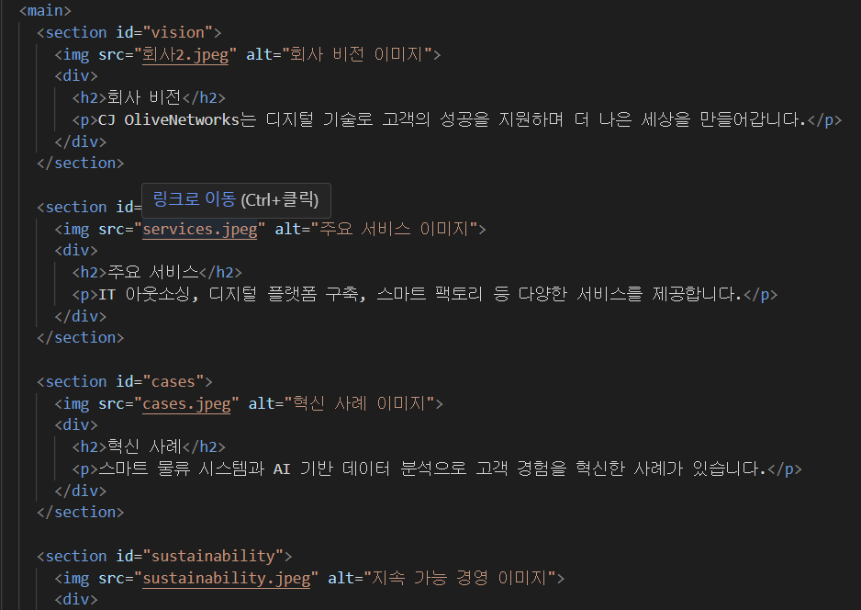
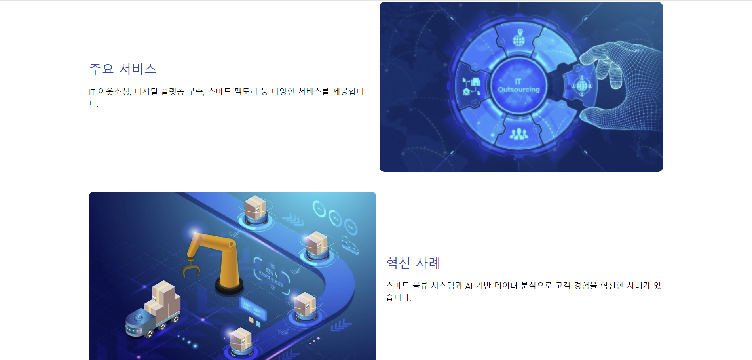
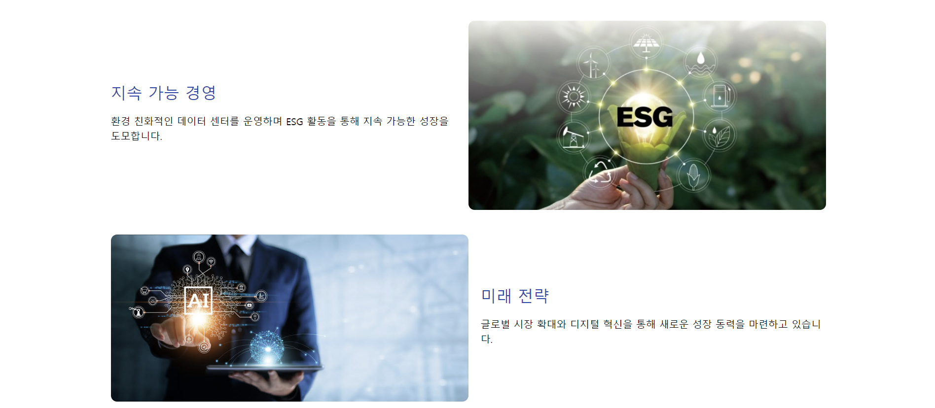
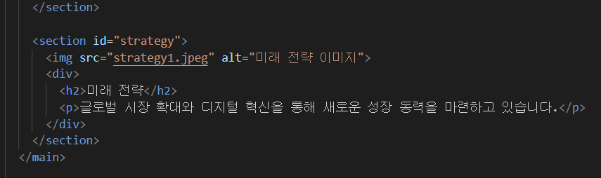

Slide 4
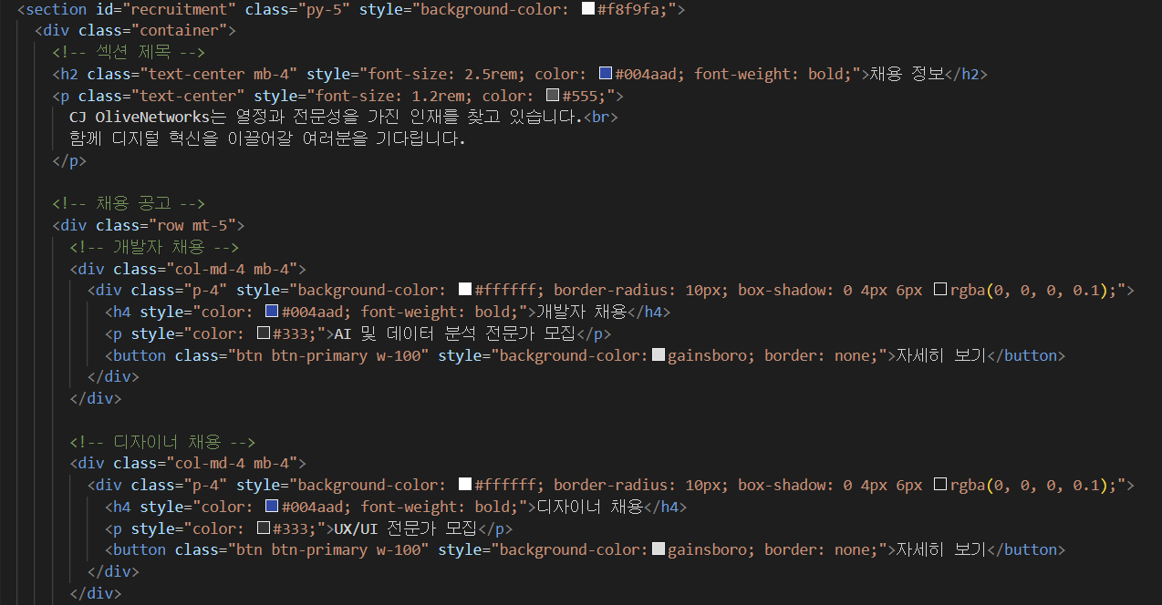
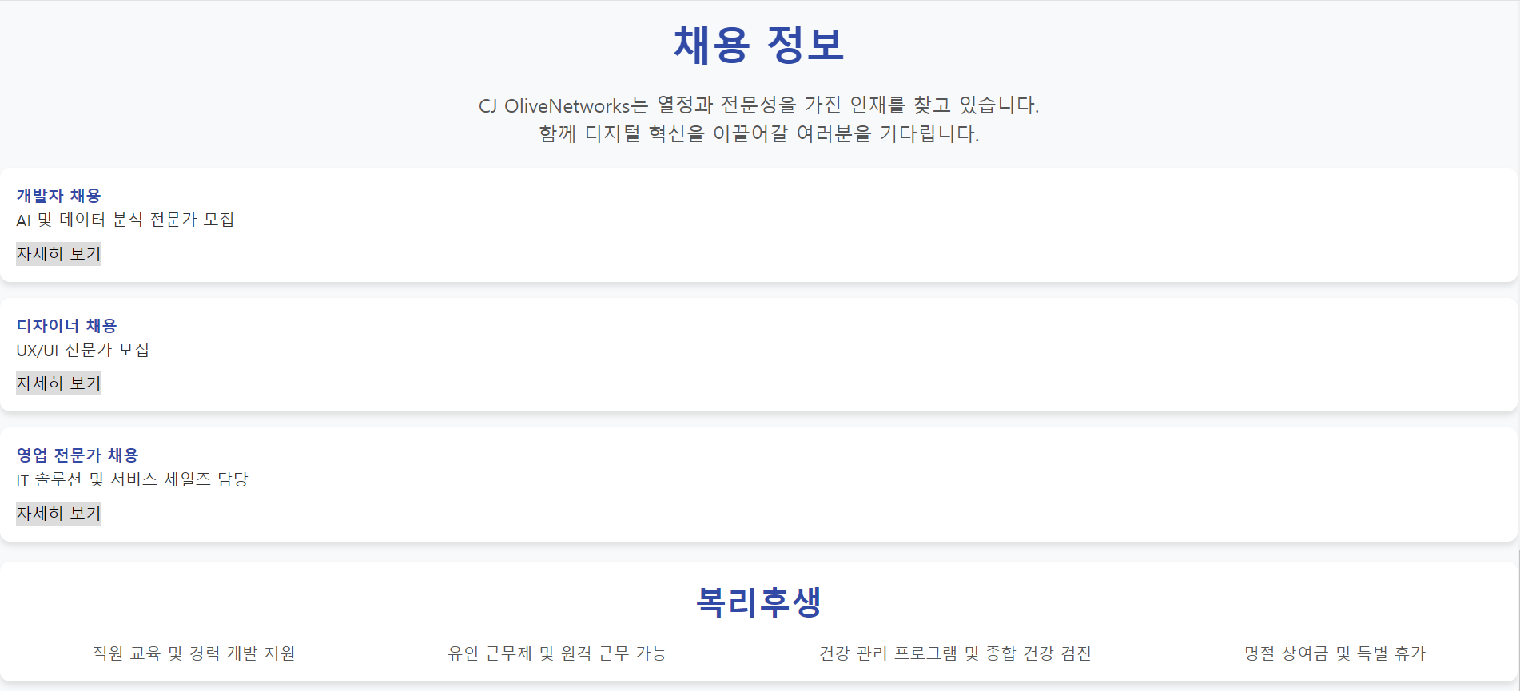
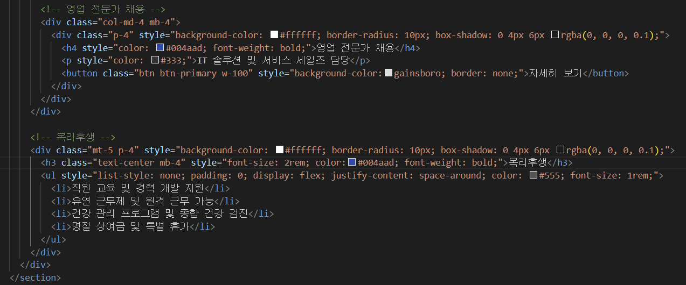
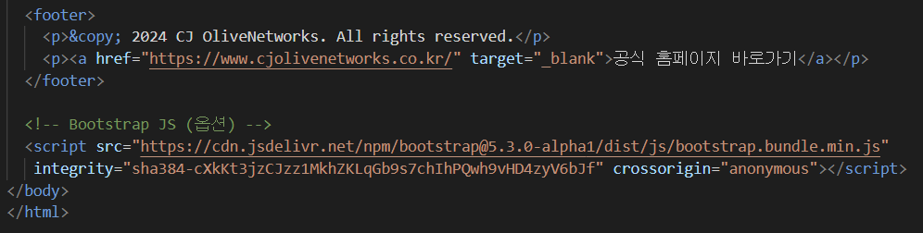

Slide 5
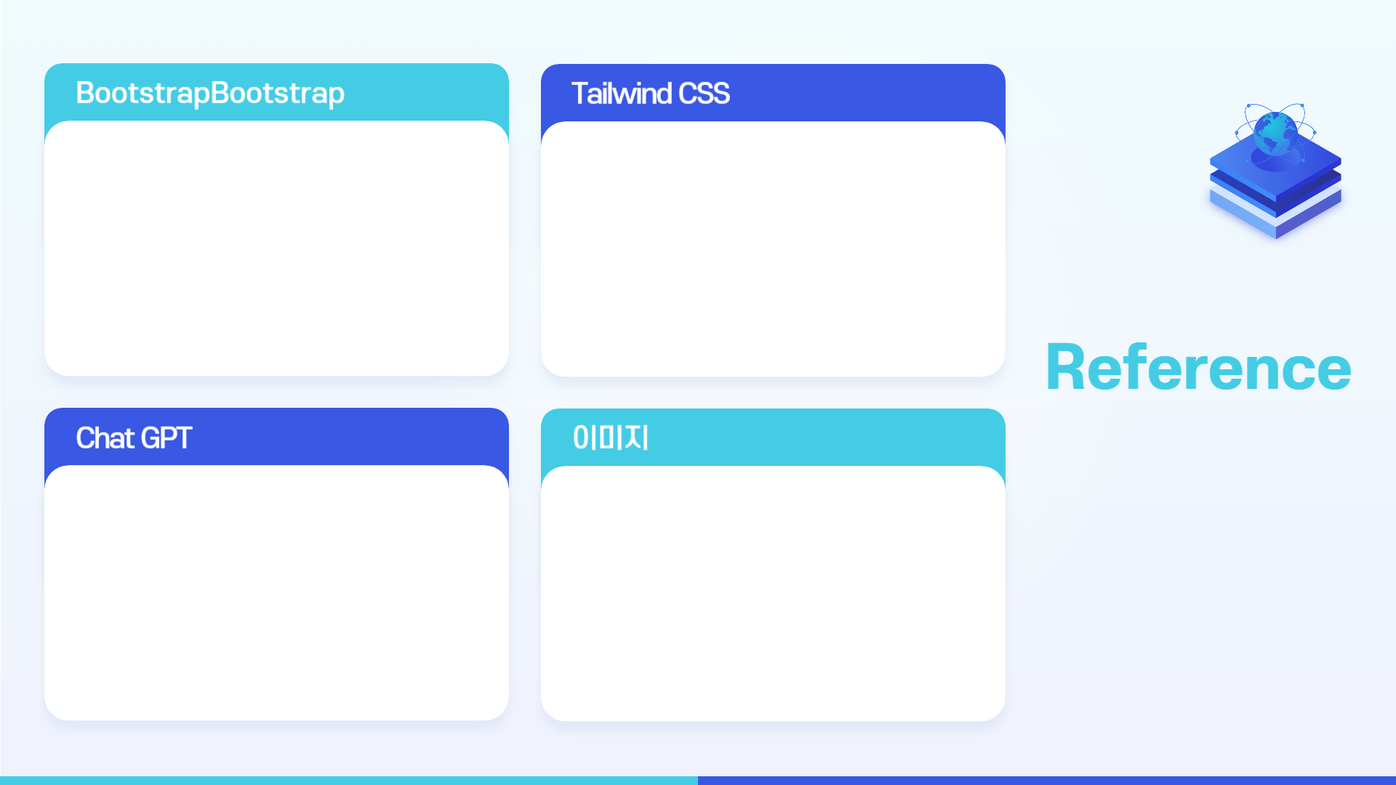



https://search.pstatic.net/common/?src=http%3A%2F%2Fimgnews.naver.net%2Fimage%2F030%2F2021%2F04%2F14%2F0002939083_001_20210414192234295.jpg&type=sc960_832
https://search.pstatic.net/common/?src=http%3A%2F%2Fblogfiles.naver.net%2FMjAyNDAzMjhfMTQg%2FMDAxNzExNjEzNTE5MzMy.MEkZtyKA4OrwwDpnZkRVooJ7N4HG7I90HzW87pxTDTIg.9h7lHxCtTvsgFD_vwqqJyhrBNfdormkB2-SH67l4ijYg.JPEG%2F1711373311436.jpeg&type=sc960_832
https://search.pstatic.net/common/?src=http%3A%2F%2Fimgnews.naver.net%2Fimage%2F5417%2F2022%2F11%2F26%2F0000039176_001_20221126100402095.jpg&type=sc960_832
https://search.pstatic.net/common/?src=http%3A%2F%2Fblogfiles.naver.net%2FMjAyMTAyMTFfMTg0%2FMDAxNjEyOTcxNDUyNDk2.hd7ejk5eUGRf3pn3K1VB-T7-sryD4tOT2Fcu2Lo26OEg.3cE6qZ00jjBHtVv0dgmz9nBtxvxbMot7xdvKp76adkwg.JPEG.jinok4798%2FKakaoTalk_20210210_225255425.jpg&type=sc960_832
https://search.pstatic.net/common/?src=http%3A%2F%2Fimgnews.naver.net%2Fimage%2F5484%2F2023%2F10%2F26%2F0000135709_001_20231026103802101.png&type=sc960_832

Slide 6
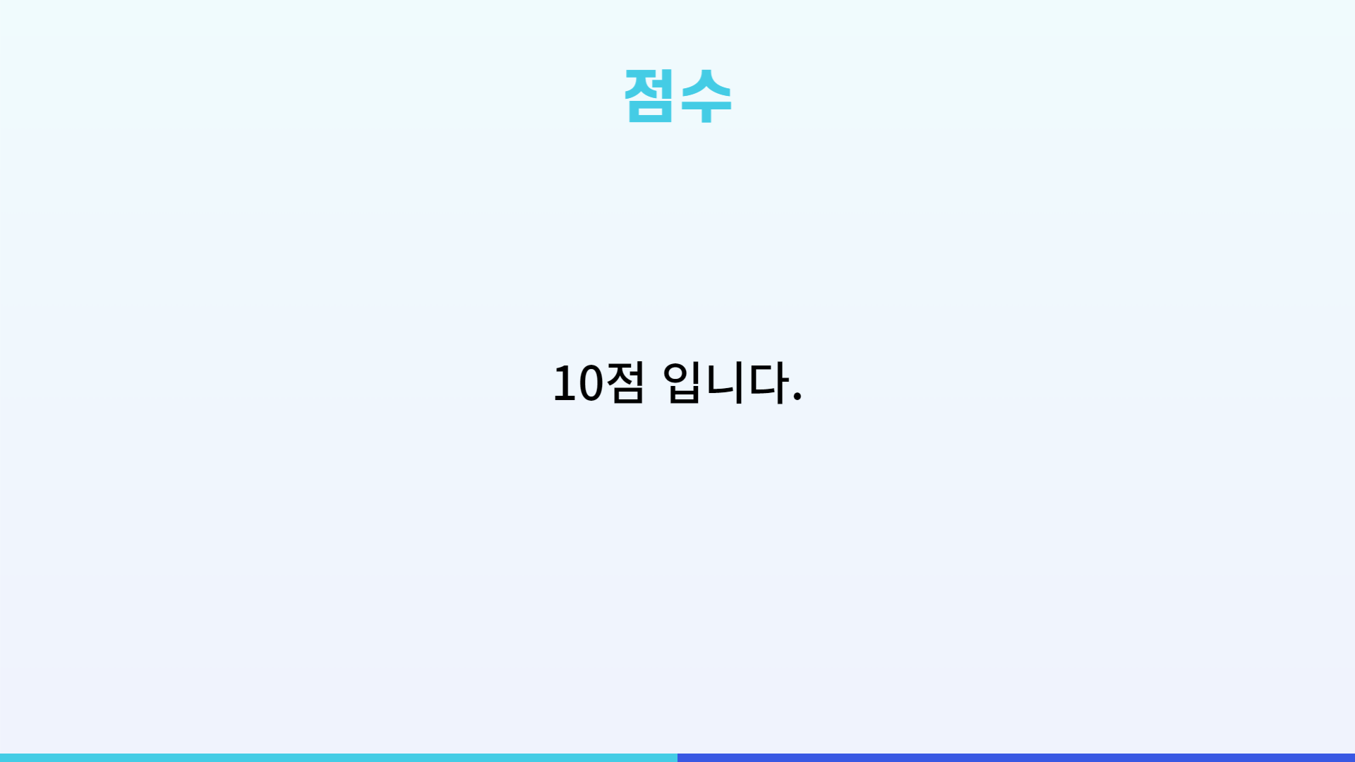

Slide 7


